Slide 1
Chapter 11:
Implementing File Systems

Slide 2
Chapter 11: Implementing File Systems
File-System Structure
File-System Implementation
Directory Implementation
Allocation Methods
Free-Space Management
Efficiency and Performance
Recovery
Log-Structured File Systems
NFS
Example: WAFL File System

Slide 3
Objectives
To describe the details of implementing local file systems and directory structures
To describe the implementation of remote file systems
To discuss block allocation and free-block algorithms and trade-offs

Slide 4
File-System Structure
File structure
  Logical storage unit
  Collection of related information
File system resides on secondary storage (disks)
File system organized into layers
File control block – storage structure consisting of information about a file

Slide 5
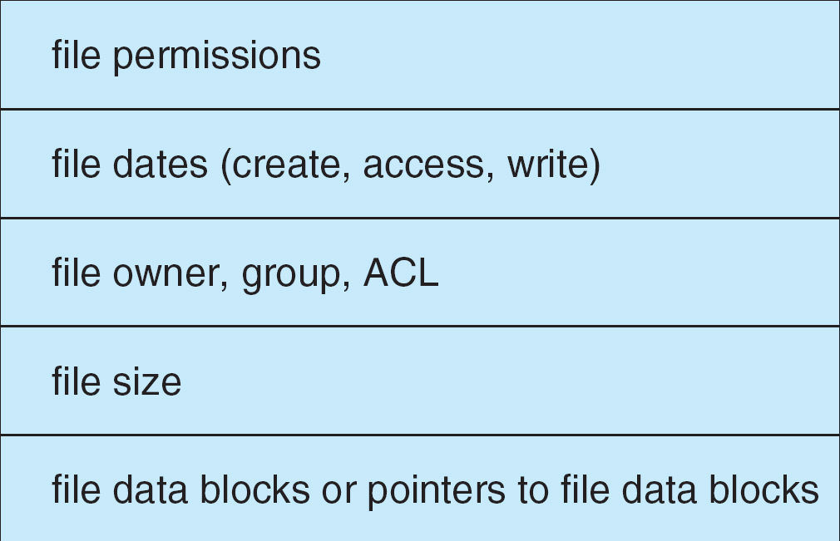
A Typical File Control Block

Slide 6
In-Memory File System Structures
The following figure illustrates the necessary file system structures provided by the operating systems.
Figure 12-3(a) refers to opening a file.
Figure 12-3(b) refers to reading a file.

Slide 7

In-Memory File System Structures

Slide 8
Virtual File Systems
Virtual File Systems (VFS) provide an object-oriented way of implementing file systems.
VFS allows the same system call interface (the API) to be used for different types of file systems.
The API is to the VFS interface, rather than any specific type of file system.

Slide 9

Schematic View of Virtual File System

Slide 10
Directory Implementation
Linear list of file names with pointer to the data blocks.
  simple to program
  time-consuming to execute
Hash Table – linear list with hash data structure.
  decreases directory search time
  collisions – situations where two file names hash to the same location
  fixed size

Slide 11
Allocation Methods
An allocation method refers to how disk blocks are allocated for files:
Contiguous allocation
Linked allocation
Indexed allocation

Slide 12
Contiguous Allocation
Each file occupies a set of contiguous blocks on the disk
Simple – only starting location (block #) and length (number of blocks) are required
Random access
Wasteful of space (dynamic storage-allocation problem)
Files cannot grow

Slide 13

Contiguous Allocation of Disk Space

Slide 14
Extent-Based Systems
Many newer file systems (I.e. Veritas File System) use a modified contiguous allocation scheme
Extent-based file systems allocate disk blocks in extents
An extent is a contiguous block of disks
  Extents are allocated for file allocation
  A file consists of one or more extents.

Slide 15

Linked Allocation

Slide 16

File-Allocation Table

Slide 17
Indexed Allocation
Brings all pointers together into the index block.
Logical view.
index table

Slide 18

Example of Indexed Allocation

Slide 19
Indexed Allocation – Mapping (Cont.)

outer-index
index table
file

Slide 20

Combined Scheme: UNIX (4K bytes per block)

Slide 21
Free-Space Management
Bit vector (n blocks)
0
1
2
n-1
…
0 ⇒ block[i] free
1 ⇒ block[i] occupied
bit[i] =

Block number calculation
(number of bits per word) *
(number of 0-value words) +
offset of first 1 bit

Slide 22
Free-Space Management (Cont.)
Bit map requires extra space
  Example:
block size = 2¹² bytes
disk size = 2³⁰ bytes (1 gigabyte)
n = 2³⁰/2¹² = 2¹⁸ bits (or 32K bytes)
Easy to get contiguous files
Linked list (free list)
  Cannot get contiguous space easily
  No waste of space
Grouping
Counting

Slide 23
Free-Space Management (Cont.)
Need to protect:
  Pointer to free list
  Bit map
    Must be kept on disk
    Copy in memory and disk may differ
    Cannot allow for block[i] to have a situation where bit[i] = 1 in memory and bit[i] = 0 on disk
  Solution:
    Set bit[i] = 1 in disk
    Allocate block[i]
    Set bit[i] = 1 in memory

Slide 24
Directory Implementation
Linear list of file names with pointer to the data blocks
  simple to program
  time-consuming to execute
Hash Table – linear list with hash data structure
  decreases directory search time
  collisions – situations where two file names hash to the same location
  fixed size

Slide 25

Linked Free Space List on Disk

Slide 26
FAT (12, 16, 32) system
File Allocation Table
Boot sector
File allocation
table 1
File allocation
table 2 (duplicate)
Root directory
Other directories and all files
0000
0001
Name
Property
Start
0002
3
File 1
…
2
0003
4
File 2
…
5
0004
EOF
File 3
…
7
2
3
4
0005
6
File1
File1
File1
0006
8
0007
EOF
0008
EOF
5
6
7
0009
0000
Cluster
File2
File2
File3
…
8
10
FAT12: 32MB
FAT16: 4GB
FAT32: 8TB
9
File2
empty
empty

Slide 27
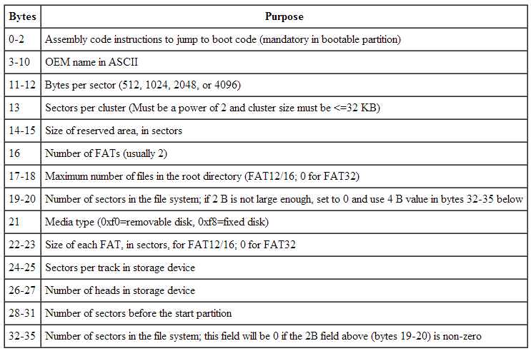

Boot sector

Slide 28
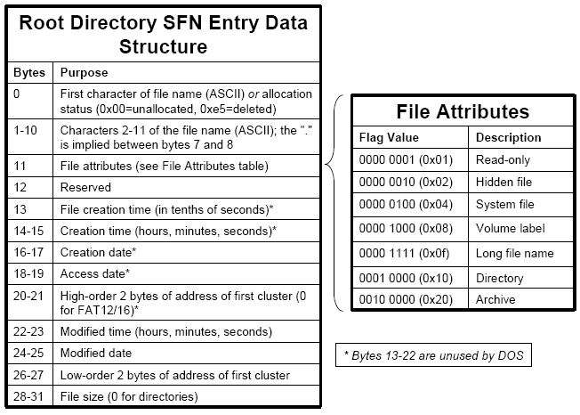

Slide 29
Long file name
…
Entry
Entry ext N
…
Entry ext 2
Entry ext 1
Entry
Entry
…
32 bytes
32 bytes

Slide 30
Entry ext
Offset | # byte | mean
0 | 1 | Entry order (start at 1)
1 | A (10d) | 5 Unicode characters –UTF16
B (11d) | 1 | If entry ext (= 0Fh)
E (14d) | C (12d) | 6 unicode characters
1C (28d) | 4 | 2 unicode characters

Slide 31

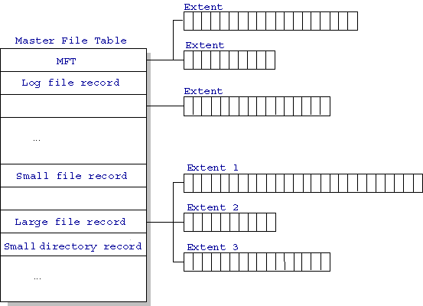
NTFS (New Technology File System)
16 exabytes
(16 billion GB)
Standard
information
Security
descriptor
Filename
Data

Slide 32
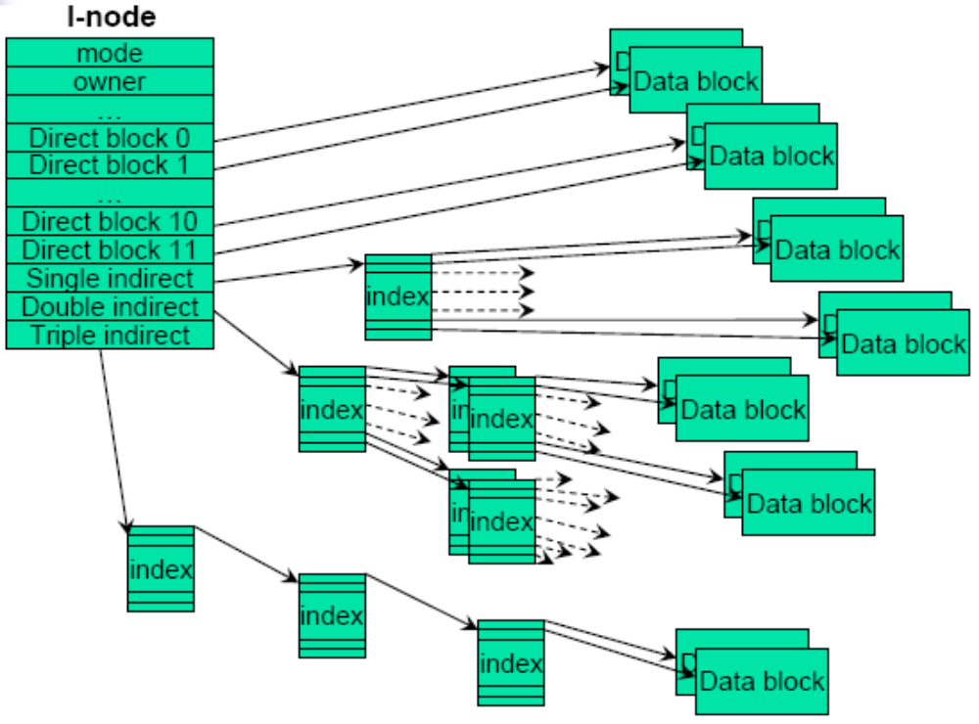
Unix /Linux file system
I-node
boot block | super block | I-node | files and directories
Single indirect: 256KB
Double indirect: 256*256 = 65 MB
Triple indirect: 256*256*256 = 16GB

Slide 33
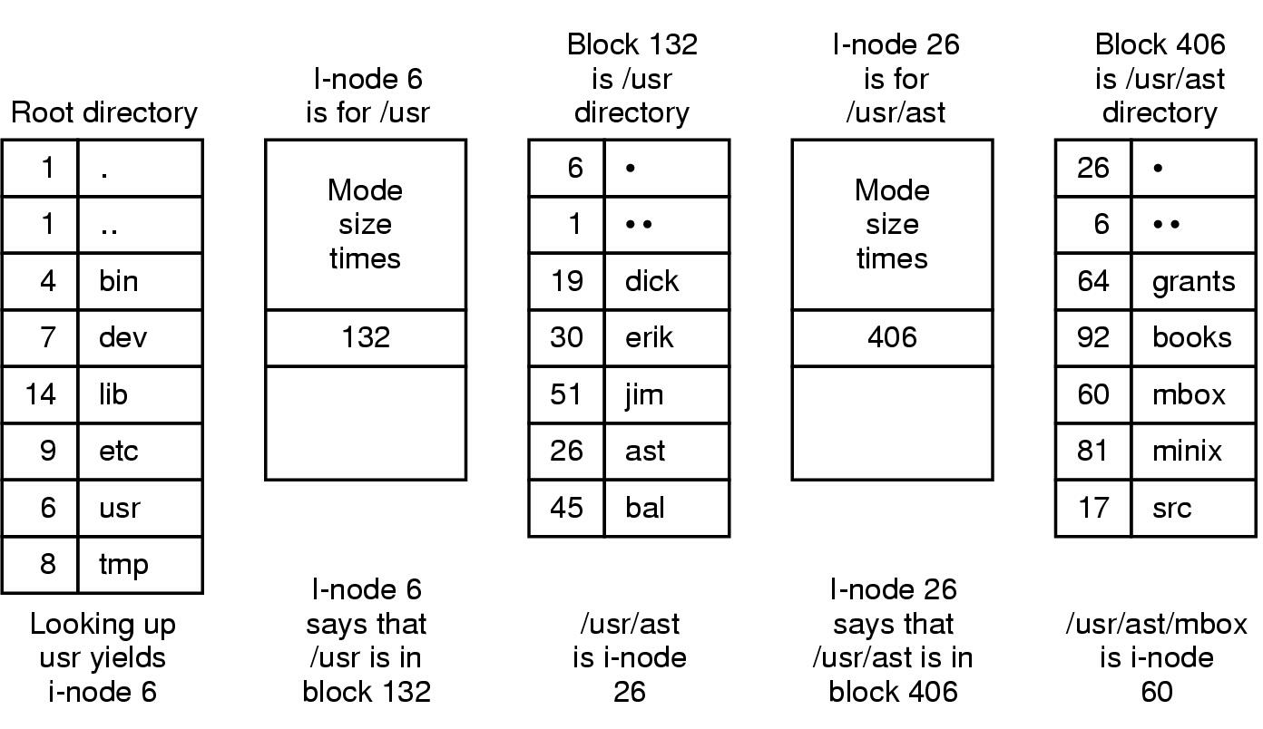
UNIX V7 file system

Slide 34
End of Chapter 11

